Slide 1
Introduction to Big Data Analytics
CSC 4760 / 6760 Big Data Programming
Spring 2020

Slide 2

Big Data Are Everywhere!
Lots of data is being collected and warehoused
Web data, e-commerce
Purchases at department/grocery stores
Bank/Credit Card transactions
Social Network

Slide 3
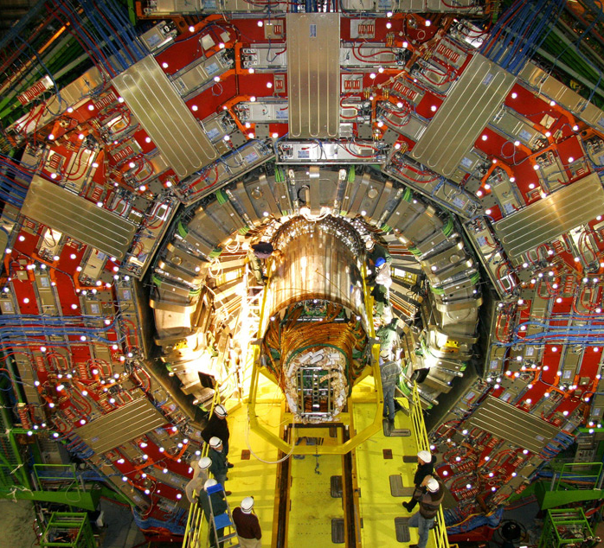
How much data?
Google processes 20 PB a day (2008)
Facebook has 2.5 PB of user data + 15 TB/day (4/2009)
eBay has 6.5 PB of user data + 50 TB/day (5/2009)
Wayback Machine has 3 PB + 100 TB/month (3/2009)
CERN’s Large Hadron Collider (LHC) generates 15 PB a year

Slide 4

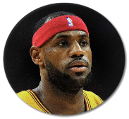



























Real Graphs are Really Big!
World Wide Web
Facebook
Twitter
60 Trillion
1.7 Billion
313 Million
Individual Pages
Active Users
Active Users
Notes:
Real world graphs are really large! For example, in web graph, each node represents a web page, and each edge represents that there are hyperlinks between two pages. Google reports that there are over 60 trillion individual web pages.
Another example is the Facebook social network. In Facebook social network, each node represents a user, and each edge represents that two users are friends. Facebook reports that there are over 1.7 billion active users.
In Twitter follower network, each node represents a user and each edge represents that a user follows another. Twitter reports that there are over 313 million active users.
We also have many other social websites, such as Google+, YouTube, LinkedIn, LiveJournal, Instagram, and Flickr.

Slide 5
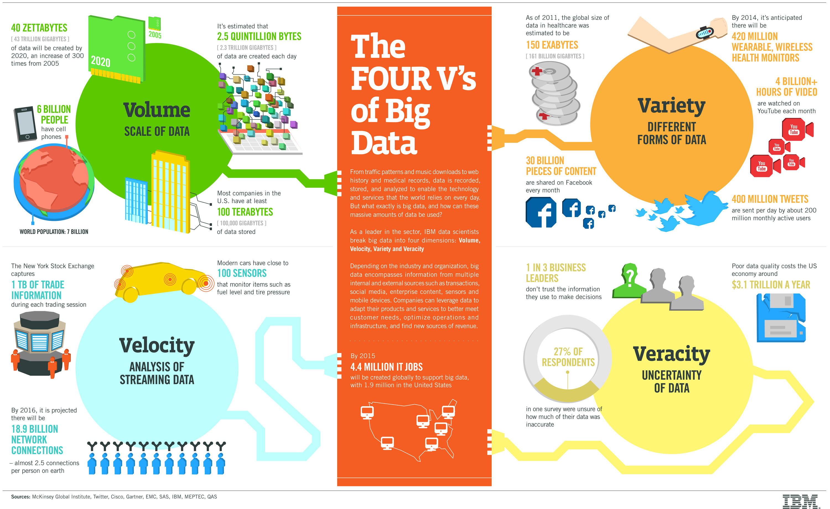

Slide 6
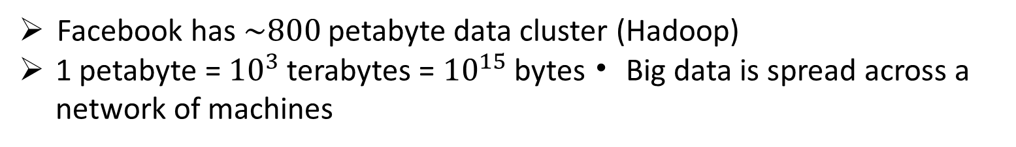
Learning from Data
What can we do when the data gets big?
Too big for the CPU memory of any single machine
Larger than the disk storage of a single machine
Recent data point
Facebook has $\sim 800$ petabyte data cluster (Hadoop)
1 petabyte = ${10}^{3}$ terabytes = ${10}^{15}$ bytes • Big data is spread across a network of machines
Big data is spread across a network of machines

Slide 7
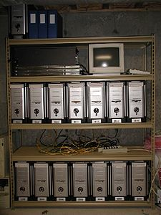

Supercomputer vs Cluster
Computer Cluster
Supercomputer
A IBM Blue Gene/P supercomputer at Argonne National Laboratory

Slide 8
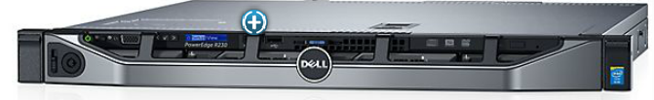
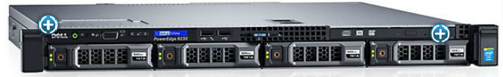
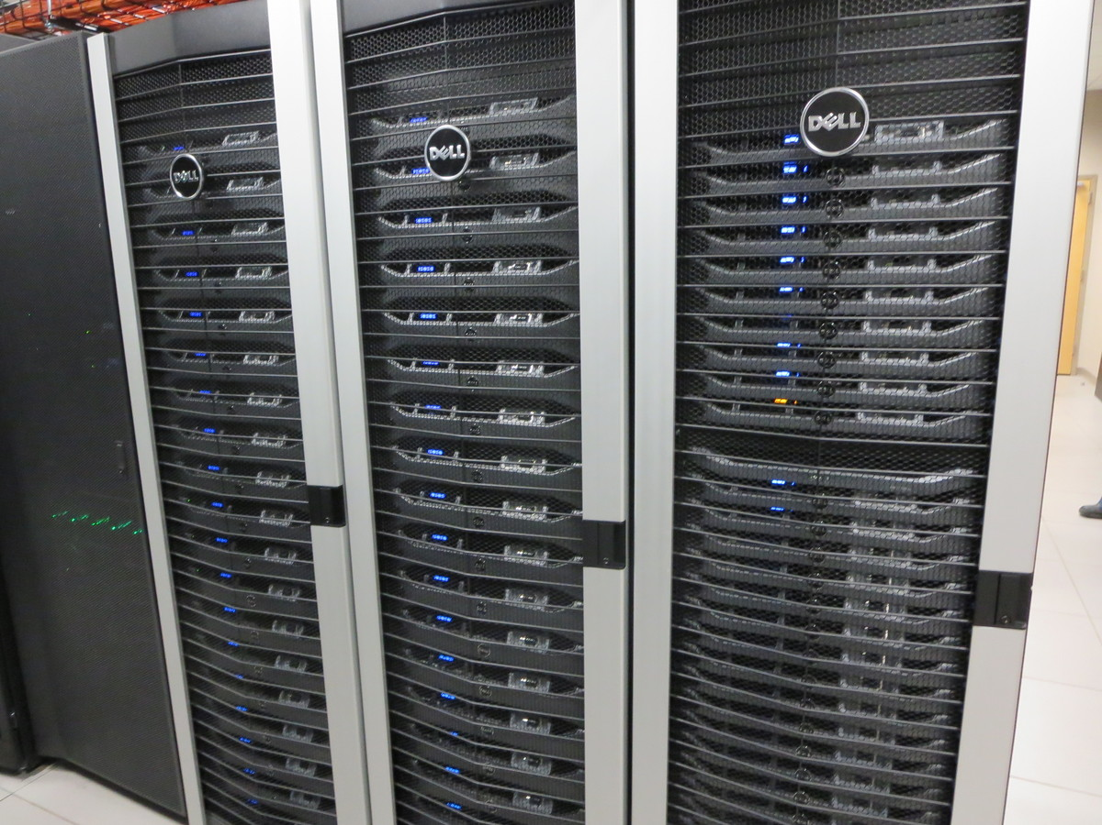
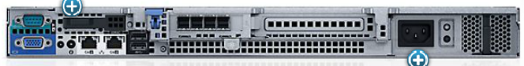
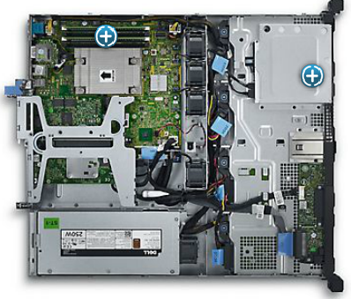
Computer Cluster
DELL PowerEdge R230 Rack Server
$729⁰⁰
Computer Cluster
DELL Cluster

Slide 9
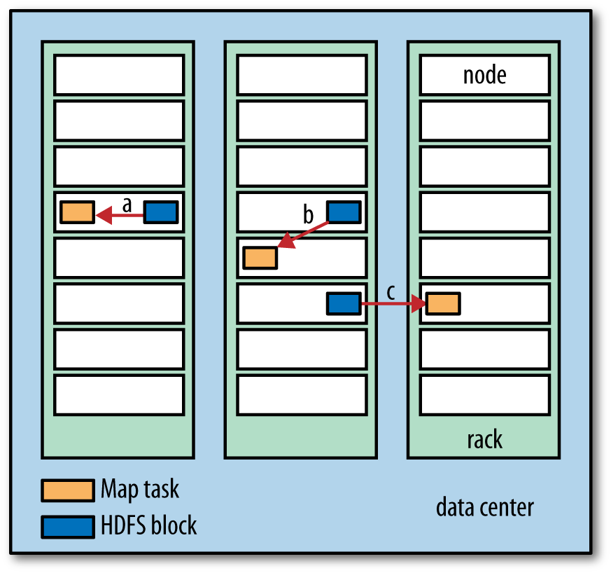
Network Communication Cost is high!
Data-local (a)
rack-local (b)
off-rack (c)

Slide 10
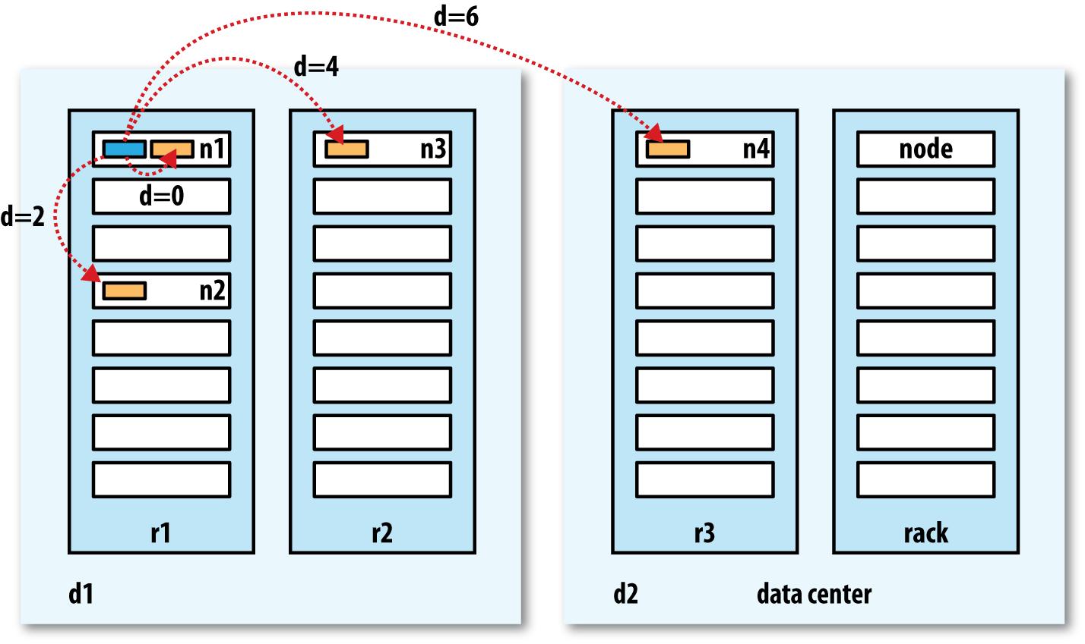
Network Distance in Hadoop
same node
different nodes on the same rack
nodes on different racks in the same data center
nodes in different data centers

Slide 11
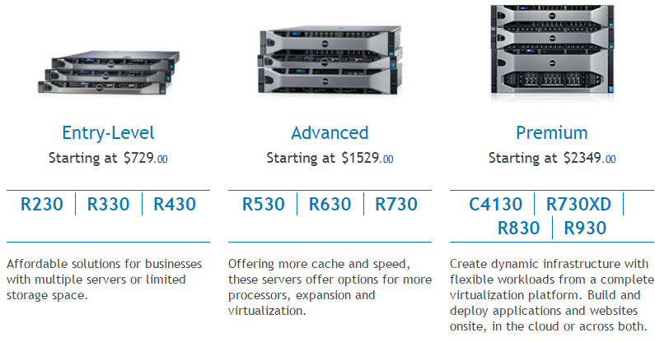
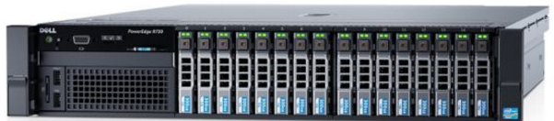
DELL Rack Server

Slide 12
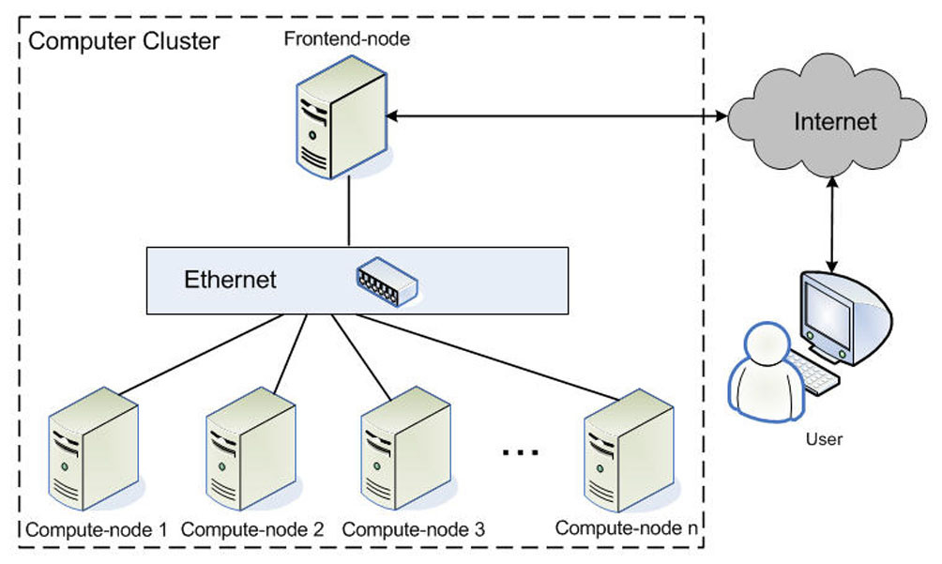
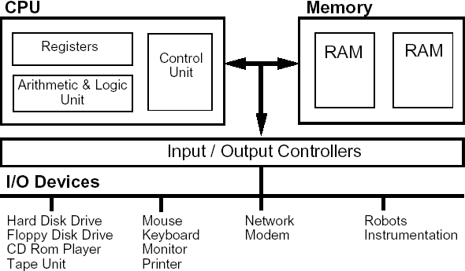
The Architecture
Computer
Computer Cluster

Slide 13
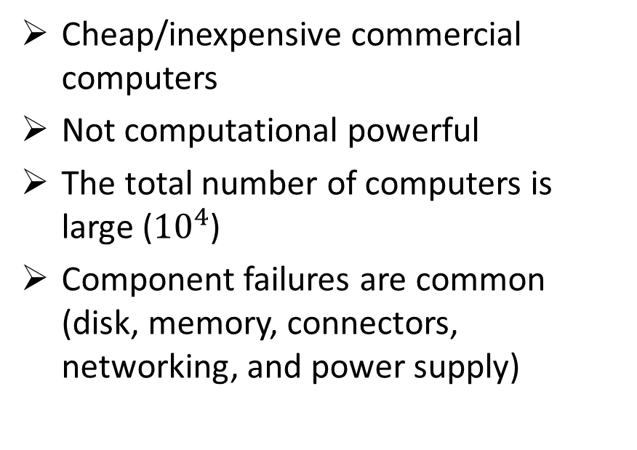
Characteristics of Computer Cluster
Cheap/inexpensive commercial computers
Not computational powerful
The total number of computers is large (${10}^{4}$)
Component failures are common (disk, memory, connectors, networking, and power supply)

Slide 14
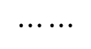
Distributed File System
Large file is divided into chunks
Each chunk is replicated into different servers
Master node maintains the (file, chunk server) lookup table
Master node
$$⋯⋯$$

Slide 15
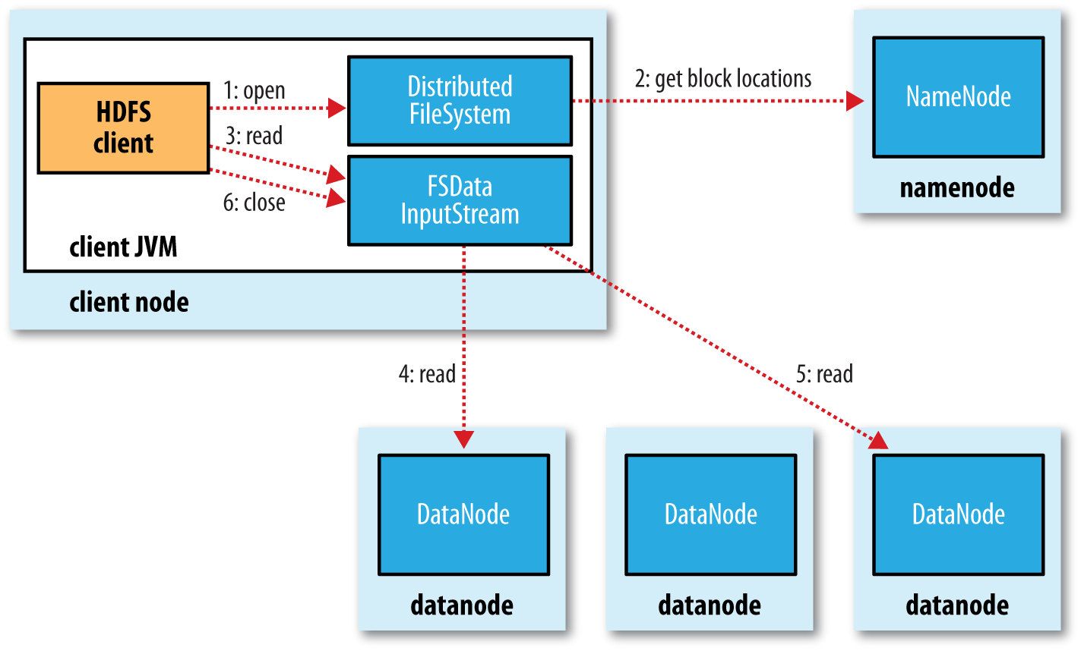
A client reading data from HDFS

Slide 16
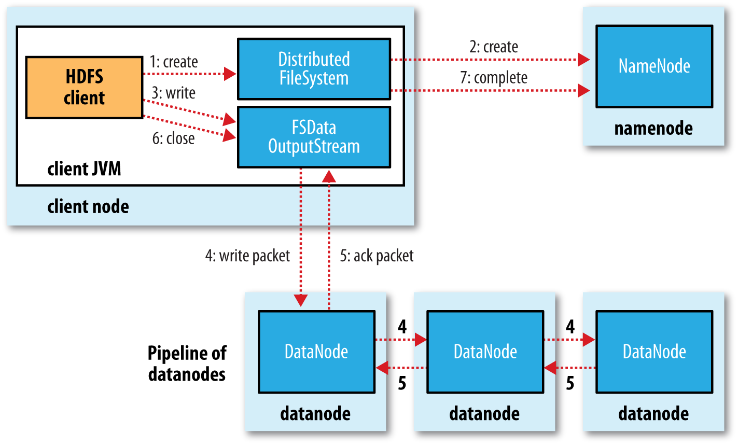
A client writing data to HDFS

Slide 17
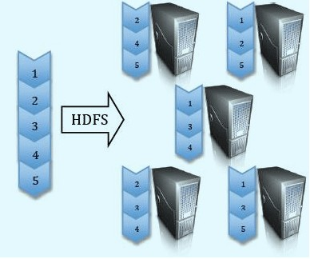
Google File System (GFS) Hadoop Distributed File System (HDFS)
Split data and store 3 replica on commodity servers

Slide 18
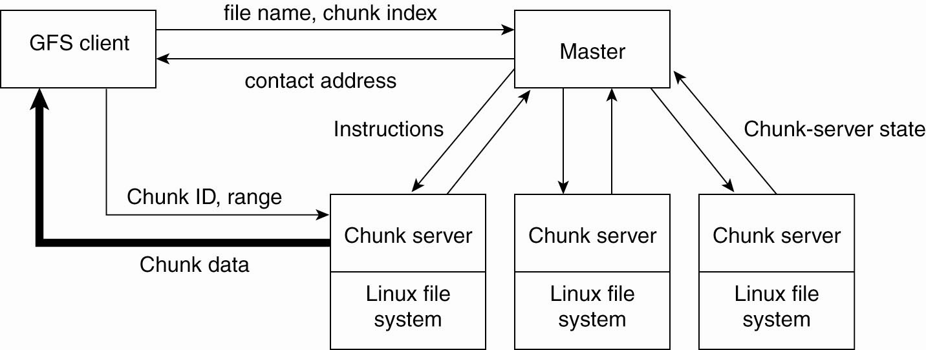
Example: Google File System
Solution: Divide files in large 64 MB chunks, and distribute/replicate chunks across many servers.
Google file system architecture
A couple of important details:
The master maintains only a (file name, chunk server) table in main memory
Files are replicated using a primary-backup scheme
The Google file system, By Sanjay Ghemawat, et al., 2003.

Slide 19
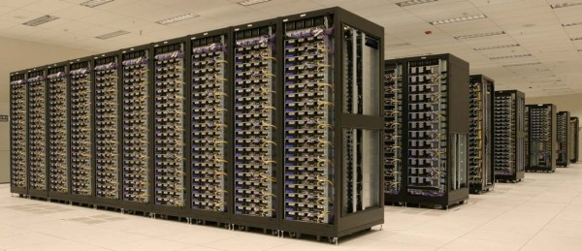
Learning from Big Data
Need to bring distributed storage and distributed processing to bear to handle big data
Cluster of machines running Hadoop at Yahoo! (Source: Yahoo!)
Issues:
Distributing computation across many machines
Maximizing performance
Minimize I/O to disk, minimize transfers across the network
Combining the results of distributed computation
Recovering from failures

Slide 20
Managing and Mining Big Data
We’ll look at two popular tools/systems
MapReduce/Hadoop
Spark
Learning Goals
Basic concepts of each
How they address the aforementioned issues?
How to solve various problems with these systems?

Slide 21
Big Data Tools
This all sounds great. What are the issues?
Coordinating the distributed computation
Handling partial failures
Combining the results of distributed computation
Tools offer a programming model that abstracts
Disk read and write
Parallelization (computation and I/O)
Combining data (keys and values)

